Slide 1
Army Research Institute
Measuring Community Embeddedness Near Army Installations: A Feasibility Study
DSPG Team: Jessica Keast (Smith College), Sean Pietrowicz (University of Notre Dame), Allegra Pocinki (Rutgers)
SDAD Team: Stephanie Shipp, Joel Thurston,
Advisors: Vicki Lancaster, Josh Goldstein, Nathaniel Ratcliff
Sponsor: Kelly Ervin, US Army Research Institute for Social and Behavioral Research
August 8, 2019

Slide 2
Community Embeddedness
“Community embeddedness refers to the attachments an individual worker maintains in a given area”
(Munyon et al. 2019)
This project conceptualizes embeddedness as “the degree to which certain county factors interact with presence of Army installation to contribute to an individual's interest in staying or moving out of that county”
Munyon, T. P., Madden, L. T., Madden, T. M., & Vigoda-Gadot, E. (2019). (Dys)functional attachments?: How community embeddedness impacts workers during and after long-term unemployment. Journal of Vocational Behavior,112, 35-50. doi:10.1016/j.jvb.2019.01.005
Notes:
Jessica

Slide 3
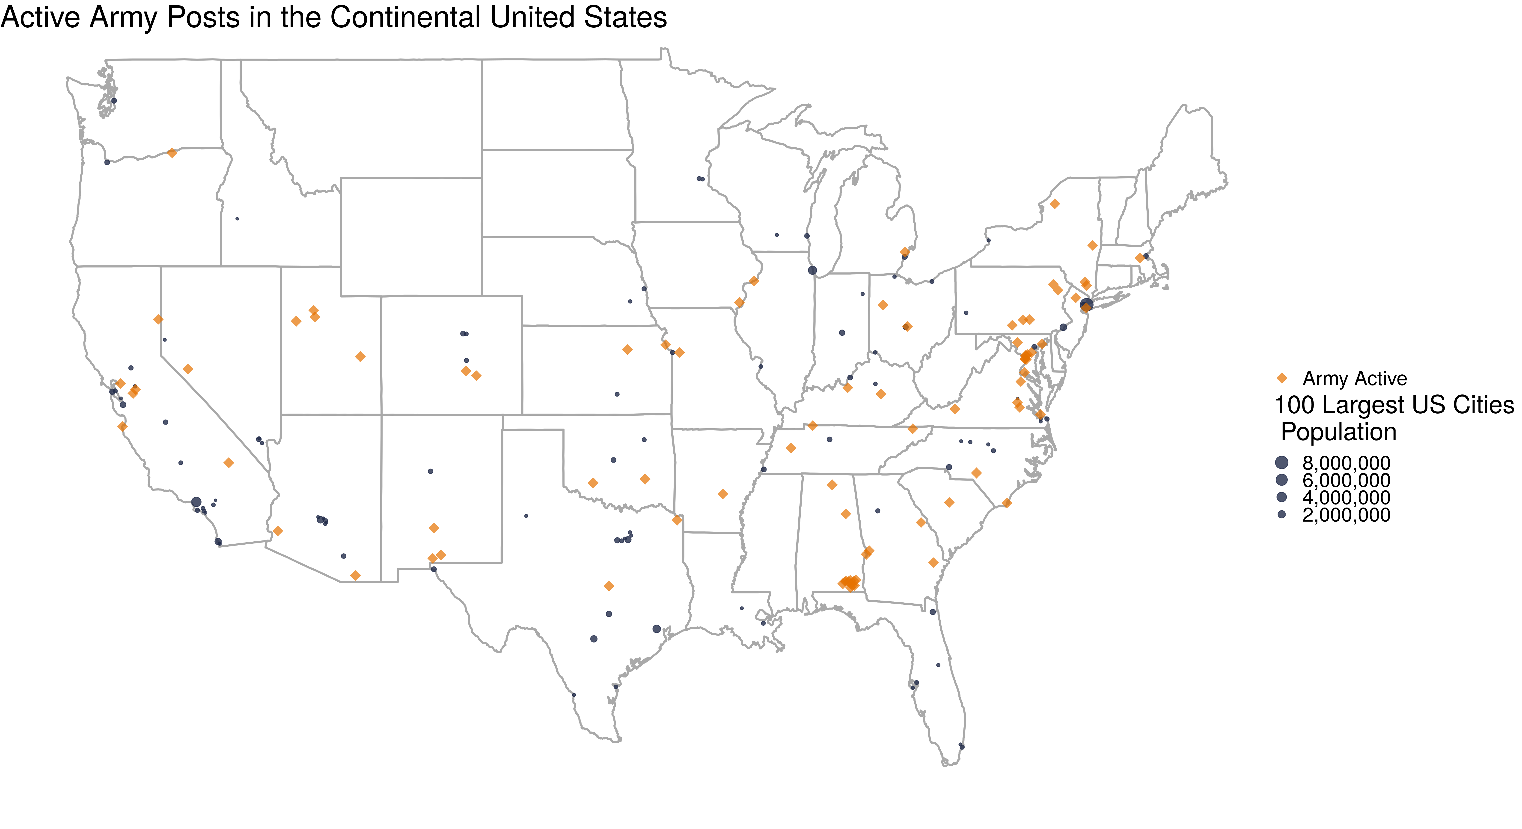
Project Summary
Project goal: Define and create composite indicators for measuring community embeddedness
Why does community embeddedness matter to the Army?​
The ARI-SDAD collaboration seeks to understand the relationship
between the Soldier’s community
and Soldier performance and behavior​
Notes:
We are focusing on measuring the Federal Sources of R&D funding which represents about almost 25% of all sources of R&D fundind or $122 billion.

Slide 4
Research Questions
What is community embeddedness, and what characteristics of a community promote embeddedness?
How does community embeddedness differ in counties with an Army post to surrounding counties?
Notes:
Jessica

Slide 5
Value to the Army
Community embeddedness may serve as an antecedent or enabler of Soldiers' development, reflecting the degree to which Soldiers have internalized core qualities of interest to the Army, such as:
Army Values (Selfless Service)
Soldier's Creed:
“I am an American Soldier...
I serve the people of the United States, and live the Army Values...
I am a guardian of freedom and the American way of life”
Soldiers' health outcomes could potentially parallel community outcomes
Soldiers may also be found to be more susceptible to negative outcomes associated with embeddedness to the degree that Soldiers differ from the larger population

Slide 6
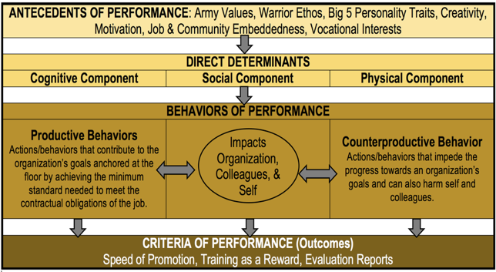
Conceptual Model of Performance & Behavioral Data Mapping
Notes:
SDAD is conducting research using multiple sources of DOD and Army data to create constructs to measure performance and behaviors.
This summer, we are working on one aspect of this measurement: How is community embeddedness defined? What are factors that define community embeddedness? If we can measure this, then we may include measures of community embeddedness in the constructs (the larger SDAD project)

Slide 7
Ethical Review
Problem Identification (Relevant Theories and Working Hypotheses)
Expected benefits: quantifying a social construct (community embeddedness) that isn’t currently measured for each county; no potential risks to participant welfare.
Assumptions: What characterizes an “embedded” community
Addressing these concerns by following common indicators discussed in past literature
The IRB for this project has already been created and approved.
Data Discovery, Inventory, Screening, & Acquisition
Using data that has been sampled to represent the population and applying survey weights.
Social media data might disproportionately skew towards younger individuals and those with higher education and income who have regular, reliable access to the internet.

Slide 8
Literature Review
Previous studies collected customized survey data
Literature focused on people in high turnover fields with many competitors
Grocery stores, hospitals not equivalent to Army (different industry alternatives, networking behavior, employment shocks)
Overarching idea is similar to our goal: social links made within an individual's community, quality of community fit, sacrifices made to live in community.
Without Soldier data, we are measuring overall community involvement around Army posts as a proxy for how the presence of an army post might impact the embeddedness of the surrounding community
Notes:
An investigation into previous literature on this field of embeddedness revealed several insights:
Job embeddedness and community embeddedness have been calculated in previous studies from survey data collected for these specific studies. Our goal to create a metric using existing publicly available data will require a different approach.
Previous studies have interviewed employees of industries with high turnover and many competitors (grocery stores, hospitals, etc.). One's propensity to leave a high-turnover industry has been measured with several metrics that do not translate (interest in industry alternatives, networking behavior, employment shocks).
Overarching concepts of community embeddedness remain relevant: social links made within an individual's community, quality of community fit, sacrifices made to live in community. We sought to capture the spirit of these categories while utilizing publicly available data sources.
Without individual soldier data, we cannot apply the techniques developed by previous papers to measure embeddedness. Instead, we are measuring overall community involvement around Army posts as a proxy for how involved soldiers can become in these communities. Maximizing the appropriateness of this measure will be a primary challenge of this project.

Slide 9
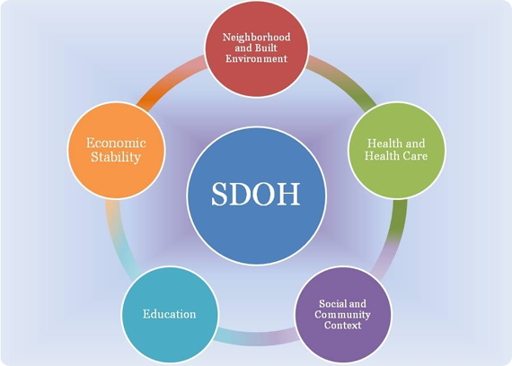
Research – Two Parts
1. Calculate indicators for counties in 2 states aligned with Social Determinants of Health
Compare community embeddedness indicators for all counties in Virginia with those counties that have Army posts
Compare differences between states (Oklahoma and Virginia)
Challenge – how to weight components of indicators?
2. Use social media data to supplement findings
Using ideas from indicators, search for terms related to community embeddedness
Challenge – Facebook data is restricted; Twitter requires approvals to obtain data; currently using blogs
Social Determinants of Health Framework
Source: https://www.healthypeople.gov/2020/topics-objectives/topic/social-determinants-of-health

Slide 10
Ideas for Community Embeddedness Composite Indicators
Neighborhood and Built Environment
housing characteristics: age, overcrowding, high housing costs, lack of kitchen/plumbing facilities
homeowners vs. renters
crime rates
air/water quality
residential segregation
commute time/distance
Open Street Maps: open space, sidewalks, playgrounds, parks
Health and Health Care
primary care physicians
teen births
infant/child mortality
preventable hospital admissions
insurance coverage
drug overdose deaths
reports of poor/fair health
Open Street Maps: liquor stores, fast food restaurants, fitness centers
Economic Stability
poverty status
employment status
income inequality
median income
food insecurity
Education
highest level of educational attainment
on-time high school graduation rate
early childhood education enrollment
Social and Community Context
membership associations
voting rate
racial/ethnic diversity
marriage rates
family size
library patronage
foster care entry
Open Street Maps: community centers, museums, religious institutions
Notes:
We are focusing on measuring the Federal Sources of R&D funding which represents about almost 25% of all sources of R&D fundind or $122 billion.

Slide 11
Data Discovery
Data source | Measures | Challenges | Keep/Shelve
American Community Survey | Social, economic, housing, and demographic characteristics | None | Keep
Virginia Department of Health, Injury & Violence | Deaths due to injury and violence | Have to request CSV files directly from Virginia Department of Health | Keep
County Health Rankings | Health outcomes, health behavior, socioeconomic factors, physical environment | None | Keep
Election Turnout, Individual Elections (Virginia) | Voter turnout data for general and special elections | None | Keep
Kids Count Data Center | Demographic indicators, economic well-being, education, health, safety for children | None | Keep
Public Libraries Survey | Public libraries within the U.S. | None | Keep
Open Street Maps | Location of various buildings and resources (e.g., open space, sidewalks, playgrounds, parks) | None | Shelve
Notes:
We are focusing on measuring the Federal Sources of R&D funding which represents about almost 25% of all sources of R&D fundind or $122 billion.

Slide 12
Data Discovery
Data source | Measures | Challenges | Keep/Shelve
Number of Crimes by Offense Type (Virginia State Police) | Crimes by offense type, drug reports, hate crimes | Decent amount of missing data | Shelve
General Social Survey (GSS) | Trends in attitudes, behaviors | Under contract, the GSS will provide data on State, PSU, County, Census tract. | Shelve, but are pursuing for future research
American Time Use Survey | How people spend their time on various activities including religious activities, socializing, unpaid childcare, housework, volunteering, etc. | Only national-level data | Shelve
Behavioral Risk Factor Surveillance System (BRFSS) | Health indicators | No county data – just state, metropolitan status | Shelve
National Health and Nutrition Examination Survey (NHANES) | Health and nutritional status of adults and children | All geography below national level is restricted. | Shelve
Department of Defense Education Activity (DoDEA) | Regional school calendars, enrollment data, accreditation reports, comprehensive assessment system, school report system | Lots of missing data for schools, no DoDEA schools near Army bases in Virginia | Shelve
Virginia Department of Health, Health Behavior | Health behaviors by health district | Geography grouped into health districts, which don’t correspond to any Census measure | Shelve
Notes:
We are focusing on measuring the Federal Sources of R&D funding which represents about almost 25% of all sources of R&D fundind or $122 billion.

Slide 13
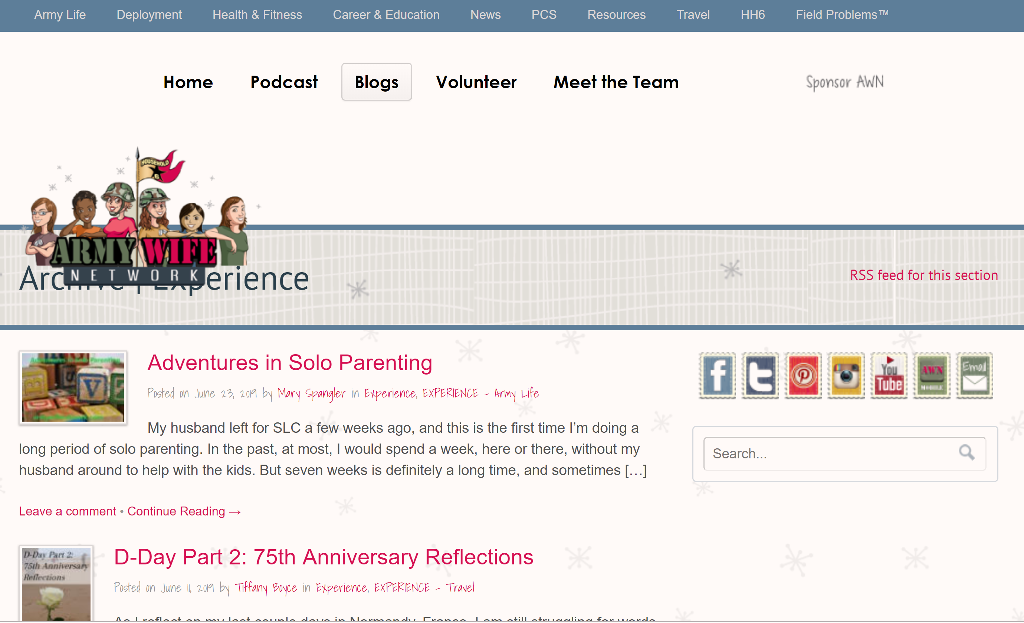
Social Media Sentiment Analysis
Interested in how often posts to social media are positive or negative
Identify keywords to search for discussions of community, social cohesion, what specific Army posts are being discussed

Slide 14
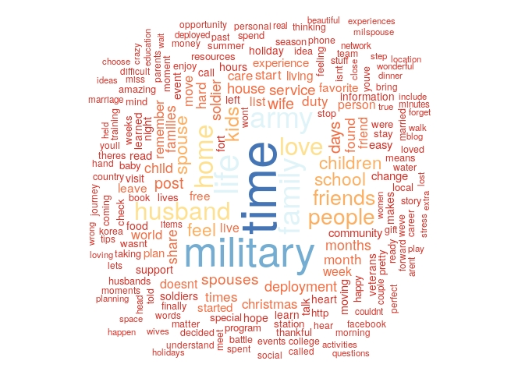
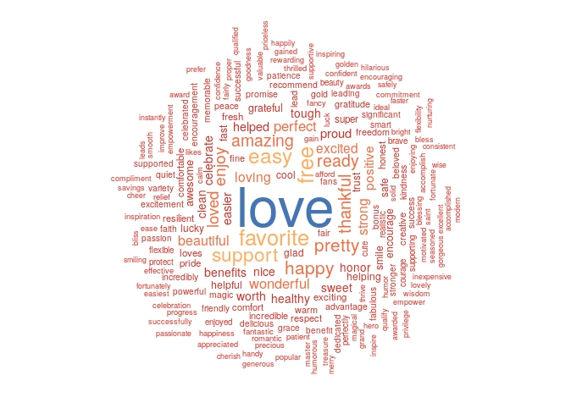
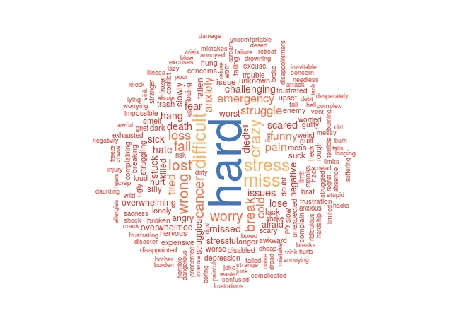
Social Media Sentiment Analysis
Top 200 words
Top 200 positive words
Top 200 negative words

Slide 15
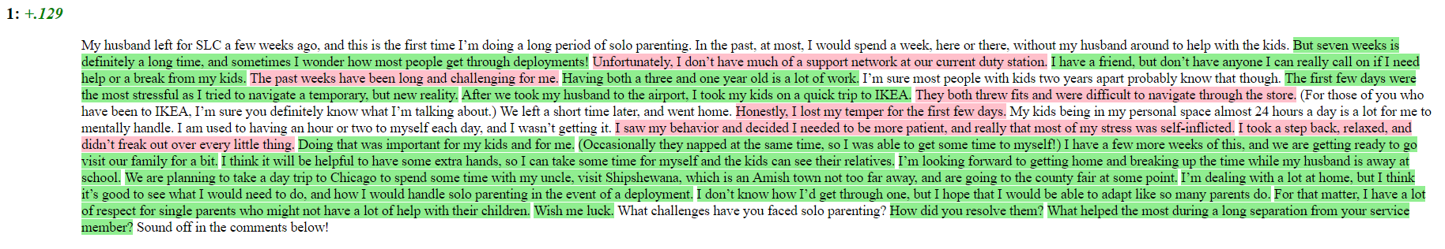
Problems with Sentiment Analysis
So many different sentiment analysis packages in R; some of the most common are sentimentr, syuzhet, meanr, SentimentAnalysis, and Stanford packages
According to the literature, the best R packages are either sentimentr or Stanford coreNLP.
sentimentr is pretty efficient and accounts for negators (it knows how to properly parse a “not” and any words after in a sentence) unlike most other packages; it also analyzes an entire sentence rather than individual words
Stanford coreNLP seems like it does everything but is super slow and resource intensive
The biggest issue is that the R package, sentimentr, marks a lot of actually negative statements as positive, which is our problem with the current SentimentAnalysis package. Stanford coreNLP is better at marking actually negative statements as negative.
Within each of these packages, a number of different dictionaries are used: AFIN, bing, nrc
None of these include military-specific terms or take into account the military meaning of certain words (like “deployment”)

Slide 16
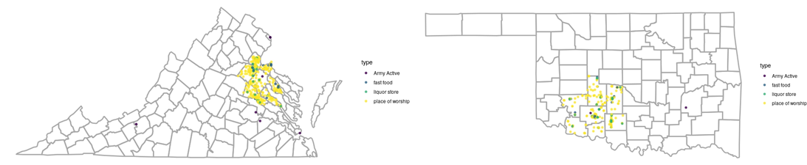
Mapping locations of interest
Thought we could use Open Street Maps to map out locations that tend to crop up around Army posts and can entice people off-post, like check cashing stores, car dealerships, tattoo parlors, bars, etc. as well as positive off-post locations like churches
we were curious to see how close or far away these locations were from the post itself
Open Street Maps has limited data for the parts of Virginia we were interested in –some simple queries of churches, for example, were only resulting in one or two churches for an entire county, which we knew was incorrect
Switched to Google API to use Google Maps to search for locations. Ran a test of liquor stores, churches, fast food restaurants in the counties of interest in Virginia and Oklahoma – still seems incomplete, but much better data than Open Street Maps

Slide 17
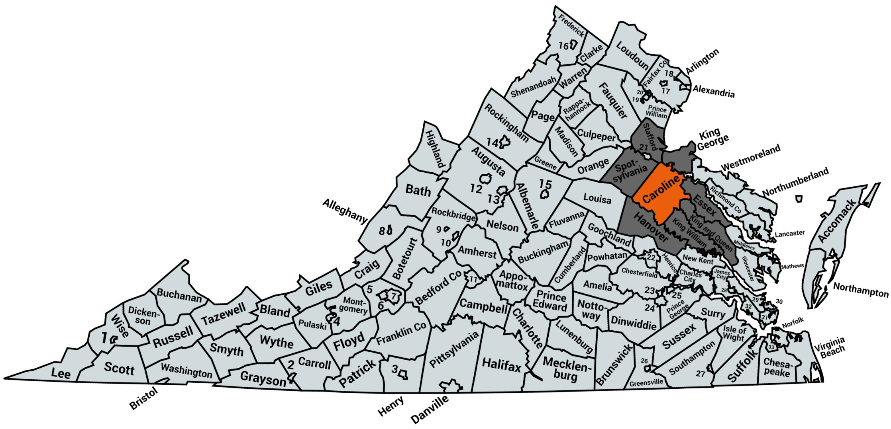
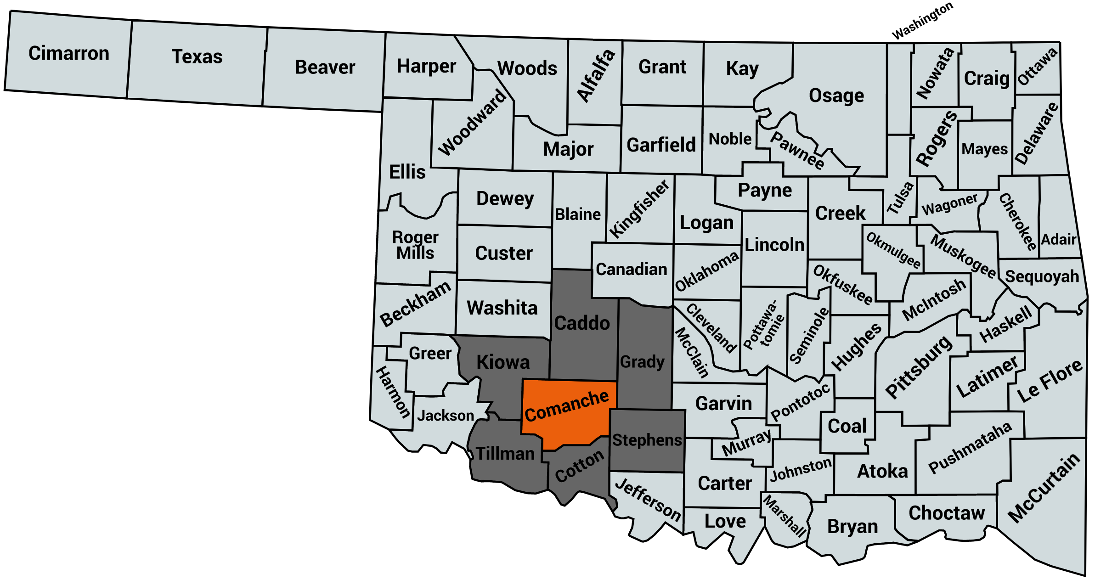
Army Post and County Selection
Ft. AP Hill (Virginia, Caroline County): Regional Collective Training Center; military units from across the U.S. are sent here for training
Ft. Sill (Oklahoma, Comanche County): home to the Field Artillery Training Command – all soldiers in Field Artillery receive their skills training here

Slide 18
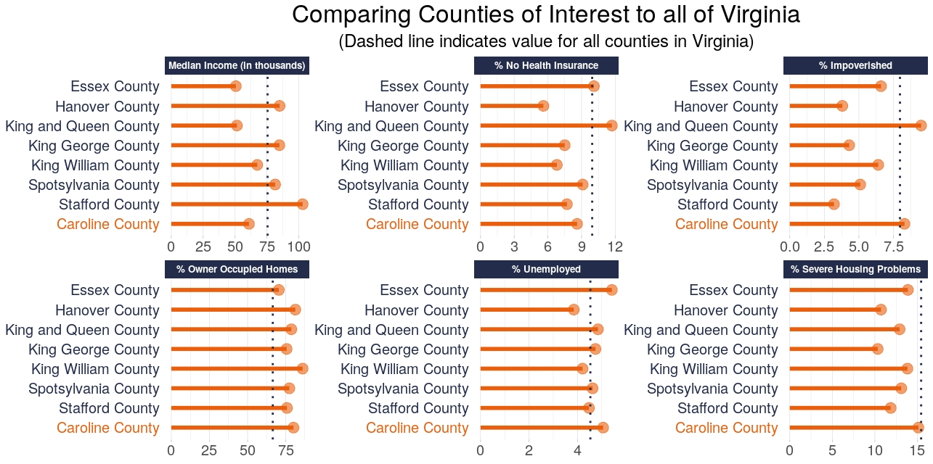
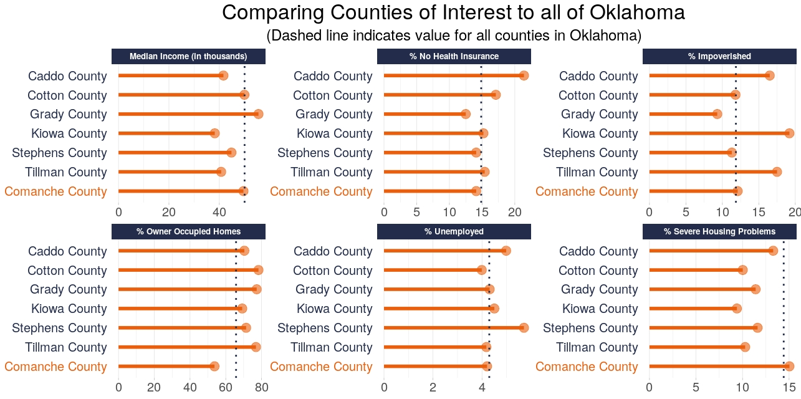
Median Income Comparison
Virginia
Oklahoma

Slide 19
Creating the Index
Analyzed our data using linear regression with the percentage of people who stayed within a county over the past 5 years as a proxy for community embeddedness
Ran best subsets and lasso regressions to identify the best predictors for our proxy and found that best subsets is a better fit
Scaled values & ran multiple linear regression
Pulled the coefficients from this model to use as preliminary weights for each of our indicators
Explored Principal Components Analysis and Factor Analysis to support decision
Scaled embeddedness construct to create index

Slide 20
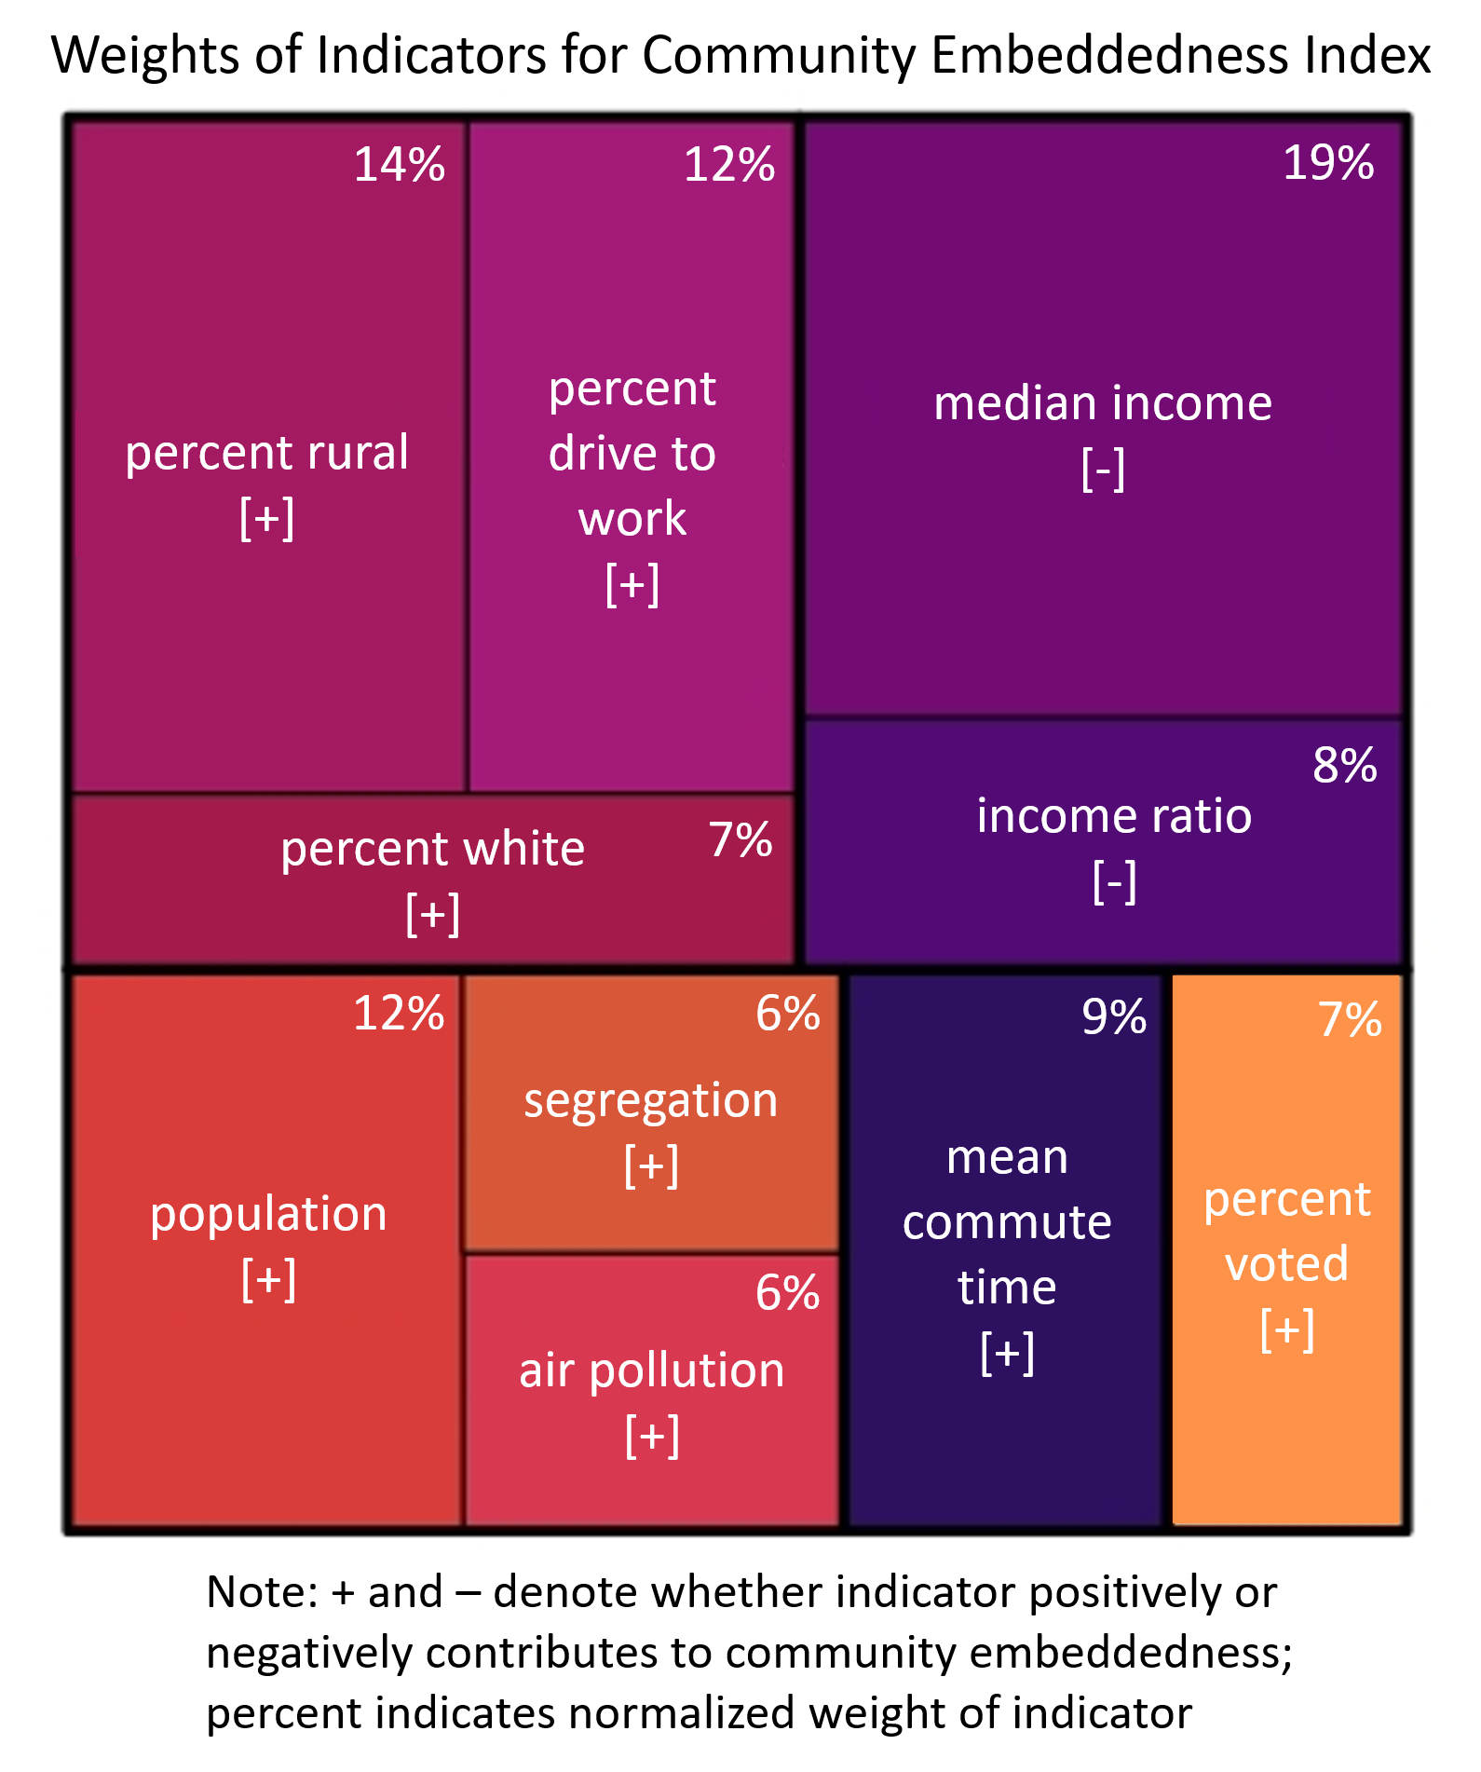
Weights of Indicators (normalized)
Income ratio: ratio of household income at 80th percentile to income at 20th
Segregation: evenness with which two groups (white/non-white) are distributed across a geographic area
Voted: Gubernatorial elections in 2017 and 2018

Slide 21
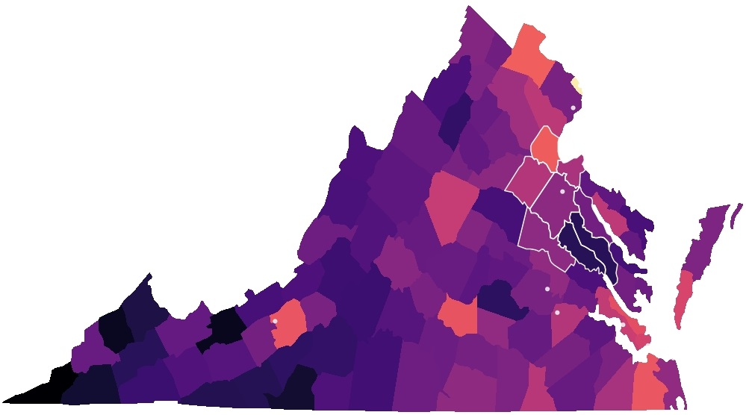
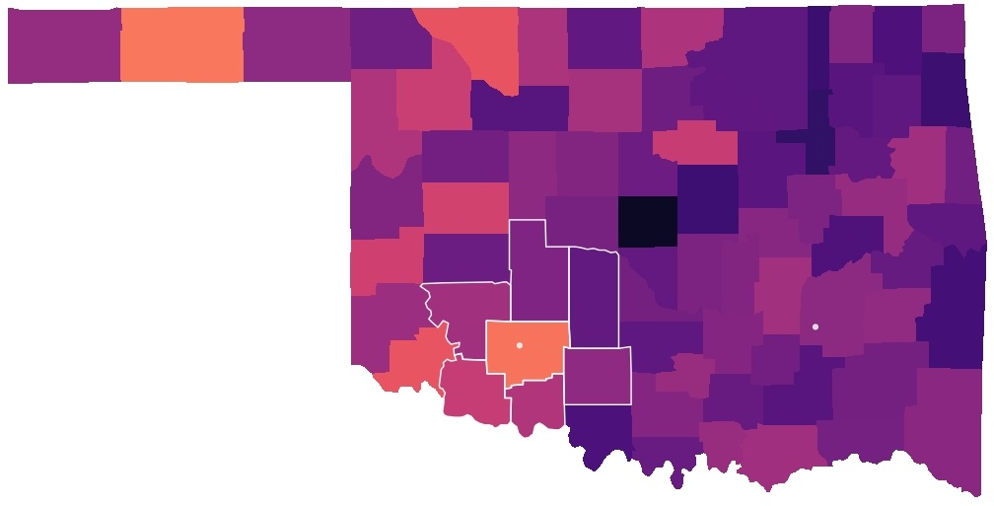

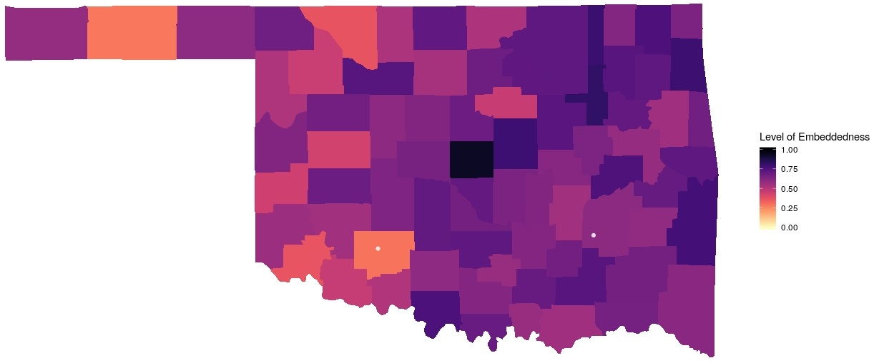

Embeddedness Index
Fort A.P. Hill, Virginia (Caroline County)
Used for training active and reserve troops for the Army, Navy, Marine Corps, and Air Force
Fort Sill, Oklahoma (Comanche County)
Home to the Field Artillery Training Command; One of four Army Basic Combat Training locations
Army installation of interest
Other Army
installations

Slide 22
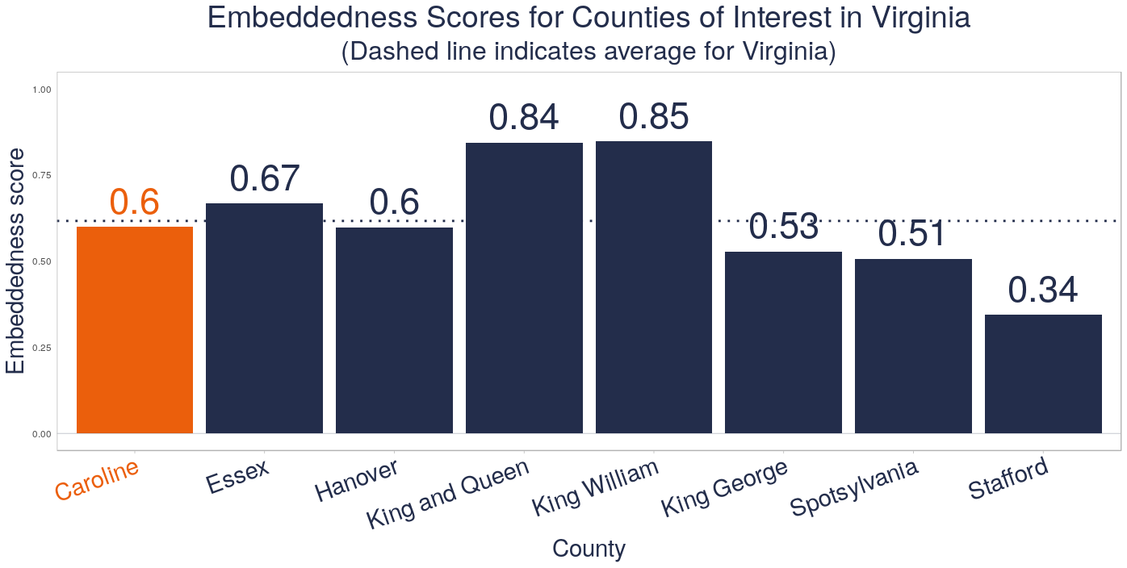
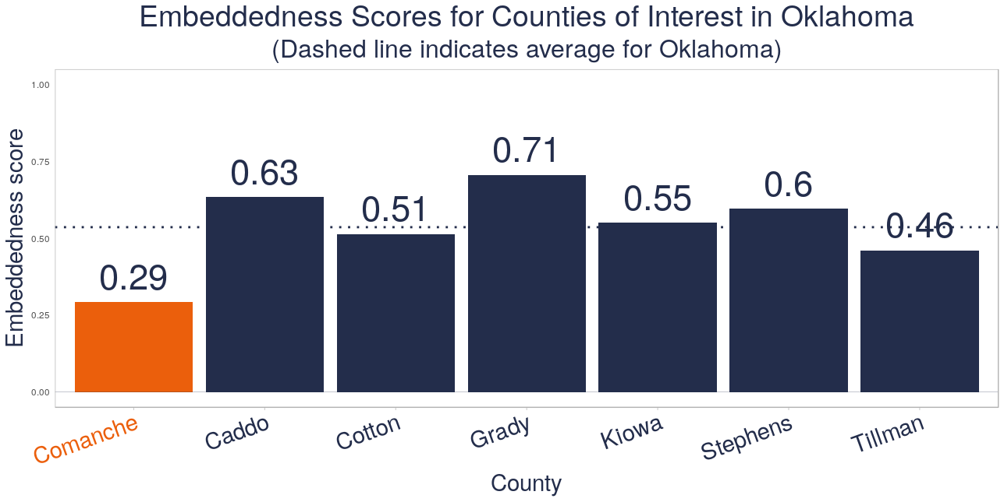

Slide 23
Findings and Next Steps
Findings:
Counties with higher levels of income tend to have lower rates of community embeddedness
Some factors illustrate aspects of place that lead to embeddedness (rural indicators: rurality, driving to work; urban indicators: air pollution, segregation)
Other factors indicate aspects of individuals within a community that point to their ability and willingness to leave (income, population, percent white, commute time, voting patterns).
Next steps:
Future models should control for race and income
Include data from all counties within the U.S., as there may be particular factors that are more prevalent in Virginia and Oklahoma than in the rest of the country
Consider other frameworks and methods, such as network analysis
Explore potential proxy outcomes other than migration patterns, which might not be the best way to capture embeddedness

Slide 24
Appendix A: BRFSS and DoDEA Data
Why can’t we use these data sources for this project?
Behavioral Risk Factor Surveillance System (BRFSS): no county-level data; data available by state or metropolitan status (city, MSA, suburb, rural), which does not accurately encapsulate the area around each Army post.
DoDEA:
Regional school calendars shows the opening/closing dates for each school as well as holiday closings
Enrollment data provides total number of students in each grade, but there are no DoDEA schools in Virginia
Comprehensive assessment system provides average test scores/percentiles per school, missing data for many schools
Annual school report system provides performance data for Terra Nova exam, missing data for many schools
Accreditation reports are PDFs for each school that list criticisms of schools/areas for improvement, missing data for many schools (text could be useful for content analysis)
Notes:
Q – how does County Health Rankings use these data? We don't know – it just says they use BRFSS as a source, but you can't get any lower than MMSA. All we know is from BRFSS: A county name was collected from the respondent during the demographics section of the interview. The name of the county was used to determine the corresponding American National Standards Institute (ANSI) county code; this code was retained as a variable in the data set. The data record from an interview with a respondent was assigned to an MMSA on the basis of the county code.
https://www.cdc.gov/brfss/annual_data/2017/pdf/2017_SMART_BRFSS_MMSA_Methodology-508.pdf

